Slide 1
markman-group.com
connect@markmanassociates.com

Slide 2



TABLE OF CONTENTS
01
OUR OFFERINGS
02
USE CASES
03
PROJECT SUPPORT
markman-group.com
connect@markmanassociates.com

Slide 3

OUR OFFERINGS
markman-group.com
connect@markmanassociates.com

Slide 4





Offerings
TAILORED APPLICATION DEVELOPMENT
DATA ENGINEERING & INFRASTRUCTURE
PROCESS
AUTOMATION
PROCESS DISCOVERY & STRATEGY
REPORTING & ANALYTICS

Slide 5
Tailored Application Development
We deliver tailored application development services that meet your unique business needs. Combining innovative technology with a deep understanding of your requirements, we ensure every solution is efficient, scalable, and aligned with your business goals, driving growth and streamlining processes.
OUR APPROACH
SEAMLESS INTEGRATION
We seamlessly integrate with existing systems, ensuring smooth data flow and enhancing your business’s operational processes.
MODULAR APPLICATION DESIGN
Our flexible, modular approach allows easy customization and scalability, ensuring the application adapts to your evolving business needs.
SCALABLE SOLUTION
We build scalable solutions that grow with your business, ensuring performance and efficiency even as user demand and complexity increase.
AUTOMATION & EFFICIENCY
We automate manual processes, reducing the time spent on repetitive tasks and boosting productivity, and also improving decision-making and collaboration.
Notes:
We specialize in delivering tailored application development services designed to meet the unique needs of your business. Our approach combines innovative technology with a deep understanding of your specific requirements, ensuring that every solution is efficient, scalable, and aligned with your business goals. We focus on providing high-quality, customized applications that drive business growth and streamline processes.

Slide 6
Process Discovery & Strategy
OUR APPROACH
We analyze your processes, systems, and infrastructure to identify improvement opportunities, delivering a strategic roadmap that transforms your reporting and analytics capabilities, driving a data-driven vision.
DISCOVERY ASSESSMENT
We evaluate existing tools, processes and data sources, conduct stakeholder interviews and analyze current reporting methods
REQUIREMENTS GATHERING
We conduct workshops with key users to document business requirements and align on KPIs and reporting objectives
GAP ANALYSIS
Through gap analysis discrepancies are identified between current and desired state, for which we provide recommendations. Assess data consistency and accessibility and evaluate report accuracy and effectiveness
GOVERNANCE & SECURITY
Assess data governance frameworks, review security protocols and identify compliance requirements.
Notes:
We specialize in delivering tailored application development services designed to meet the unique needs of your business. Our approach combines innovative technology with a deep understanding of your specific requirements, ensuring that every solution is efficient, scalable, and aligned with your business goals. We focus on providing high-quality, customized applications that drive business growth and streamline processes.

Slide 7
Data Engineering & Infrastructure
OUR APPROACH
Enable your business to harness data-driven growth through our cutting-edge data architecture and cloud-based analytical infrastructure solutions.
SCALABLE ARCHITECTURE DESIGN
We tailor data infrastructure solutions to meet business needs, whether through full enterprise data lakes, targeted data warehouses, or streamlined workflow-driven processing for optimal efficiency.
SEAMLESS
DATA INTEGRATION
We implement robust ingestion pipelines using APIs, automation tools, and cloud storage to ensure reliable, real-time or batch data flow across all systems.
OPTIMIZED DATA PROCESSING
We design efficient transformation and curation frameworks, leveraging SQL-based modeling, governance structures, and performance tuning to enable fast, accurate insights.
FUTURE-READY SOLUTION
Our cloud-native, scalable approach supports advanced analytics, AI/ML capabilities, and automation, ensuring adaptability for evolving business needs.
Notes:
We specialize in delivering tailored application development services designed to meet the unique needs of your business. Our approach combines innovative technology with a deep understanding of your specific requirements, ensuring that every solution is efficient, scalable, and aligned with your business goals. We focus on providing high-quality, customized applications that drive business growth and streamline processes.

Slide 8
Reporting & Analytics
OUR APPROACH
Our approach to reporting and analytics is designed to provide real-time insights, improve decision-making, and enhance operational efficiency. By centralizing data collection, automating report generation, and enabling interactive visualizations, users can track key metrics, identify trends, and ensure compliance across various business processes.
DATA GATHERING AND INTEGRATION
All process-related data is collected and stored in a structured database.
AUTOMATED
REPORT GENERATION
Create scheduled and on-demand reports with key performance metrics.
Automate report updates and transformations.
REAL-TIME DASHBOARDS AND INSIGHTS
Provide interactive dashboards with filtering, visualization, drill down and trend analysis capabilities.
CUSTOM ALERTS AND
NOTIFICATION
Configure automated alerts for threshold breaches, or critical insights to enable proactive decision-making.
Notes:
We specialize in delivering tailored application development services designed to meet the unique needs of your business. Our approach combines innovative technology with a deep understanding of your specific requirements, ensuring that every solution is efficient, scalable, and aligned with your business goals. We focus on providing high-quality, customized applications that drive business growth and streamline processes.

Slide 9
Process Automation
OUR APPROACH
Our approach streamlines automation by integrating data retrieval, processing, and approval workflows into a centralized system. By reducing manual effort, improving data accuracy, and enhancing process visibility, this automation solution optimizes efficiency while allowing for future scalability.
AUTOMATED
DATA
RETRIEVAL
The system extracts relevant information from designated sources such as emails, databases, or external platforms.
DATA PROCESSING AND
EXTRACTION
Key details are identified, formatted, and validated using automation tools like OCR, AI, or rule-based processing.
APPROVAL AND WORKFLOW MANAGEMENT
Users review, edit, and approve processed data within a structured web application.
REPORTING
AND
DATA EXPORT
Users can generate reports, export structured data in various formats, and monitor process performance.
Notes:
We specialize in delivering tailored application development services designed to meet the unique needs of your business. Our approach combines innovative technology with a deep understanding of your specific requirements, ensuring that every solution is efficient, scalable, and aligned with your business goals. We focus on providing high-quality, customized applications that drive business growth and streamline processes.

Slide 10

USE CASES
markman-group.com
connect@markmanassociates.com

Slide 11
Proposal / Quoting Tool
INDUSTRY
OUR APPROACH
Customizable Proposal Templates
Tailor proposals to specific client needs, including detailed breakdowns of costs, materials, and labor, ensuring transparency and professionalism.
Integration with Existing Systems
Seamlessly integrates with CRM, project management, and accounting tools to keep all client data up-to-date and connected.
This solution is specifically designed for construction firm that need to generate detailed proposals and quotes for clients efficiently. It’s ideal for companies who deal with complex pricing and need to quickly create customized proposals with accurate cost estimations and material lists.
THE CHALLENGE
Clients faced following issues:
Manual, time-consuming quoting: Complex pricing takes too long and is prone to errors.
Managing multi-component proposals: Keeping track of materials, labor, and logistics in large proposals was inefficient.
Lack of integration: Difficulty in updating proposals with real-time data from other systems.
Need for quick adjustments: Clients often request changes to proposals, requiring rapid updates that were hard to manage manually.
Automated Price Calculations
The tool automatically generates quotes by calculating costs based on a predefined database of rates for materials, labor, and other services.
Real-Time Collaboration
Team members can collaborate on proposals in real time, enabling fast adjustments and streamlined approval workflows.

Slide 12
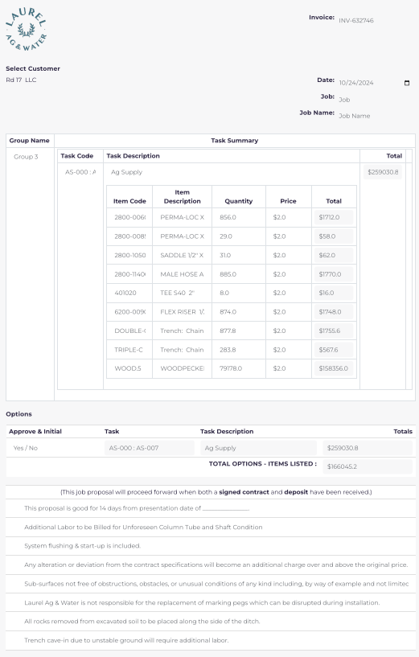
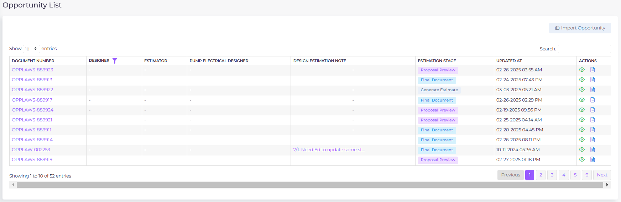
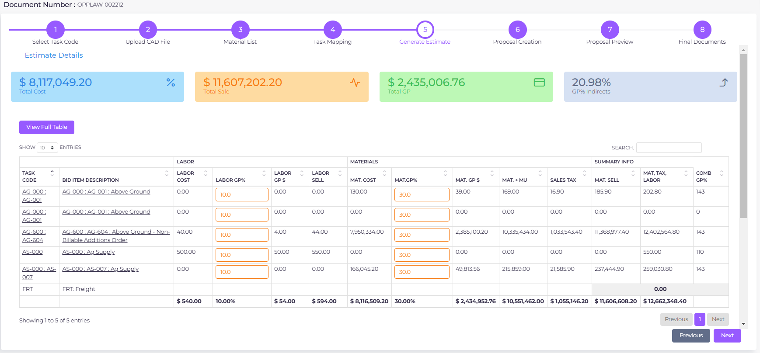
Proposal / Quoting Tool
RESULTS & VALUE CREATED
Increased Revenue
By providing consistent and accurate pricing, the tool helps ensure more competitive quotes, improving the chances of winning bids and increasing overall revenue.
Boosted Client Retention
By enabling faster proposal adjustments and tailored client interactions, businesses can create more responsive and positive experiences, improving client satisfaction and fostering long-term relationships.
Actionable Insights for Smarter Decisions
The tool provides detailed insights into proposal performance, helping businesses track key metrics, optimize their pricing strategies, and enhance future proposal outcomes.
Faster Proposal Turnaround
Clients report a 50% reduction in time spent on creating proposals, allowing sales teams to respond faster to client requests and close deals more quickly.

Slide 13
Rental Tool
INDUSTRY
OUR APPROACH
Designed specifically for agricultural and construction equipment rental companies, this solution streamlines the management of equipment rentals. From machinery to tools, this platform optimizes rental orders, tracks inventory, and automates billing, ensuring you can scale your business while providing clients with reliable, timely rentals for their needs.
Accurate Billing
Automated calculations for rental periods, fees, and taxes ensure accurate invoicing every time.
Optimized Delivery and Pickup
Automate scheduling and tracking for deliveries and pickups, reducing delays and errors.
THE CHALLENGE
Company faced issues such as:
Manual Order Management leading to errors and inefficiencies.
Stock Discrepancies that cause delays in fulfilling customer orders.
Complex Billing based on rental duration and item conditions.
Missed Delivery/Return Deadlines, which can hurt customer satisfaction.
Seamless Order Management
Streamlined creation, tracking, and management of rental orders from start to finish.
Real-Time Inventory Updates
Track available, rented, and returned items across all locations and warehouses.

Slide 14
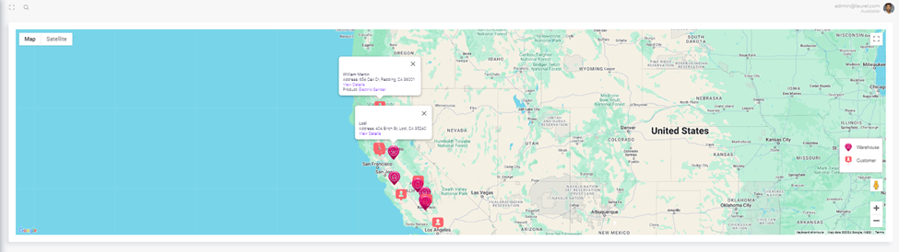
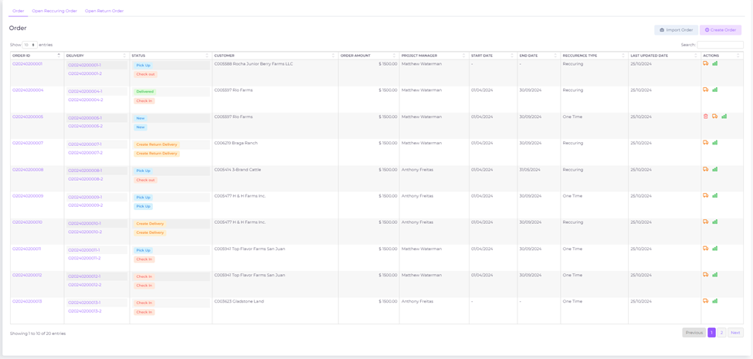
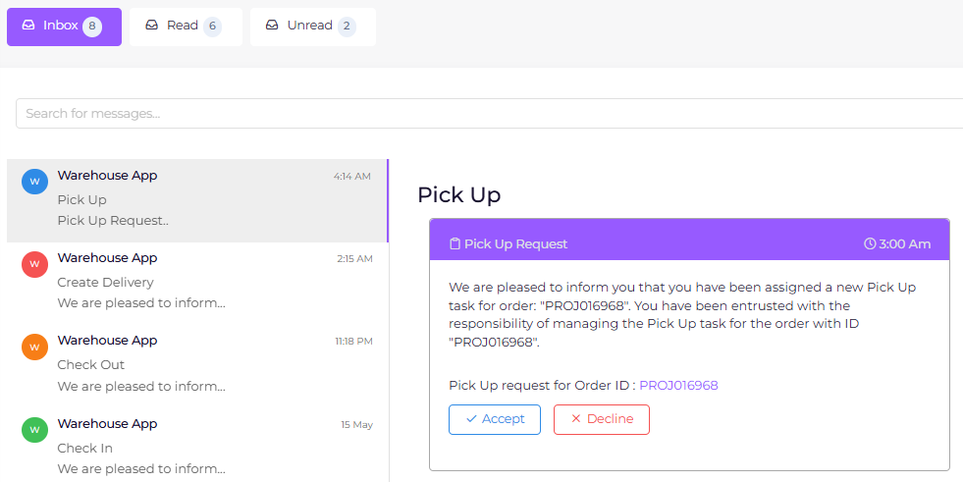
Rental Tool
RESULTS & VALUE CREATED
Revenue Growth
Maximizes revenue through accurate billing, optimized inventory usage, and seamless order processing, ensuring higher returns on equipment.
Customer Satisfaction
Improved customer experience through timely deliveries, better communication, and personalized rental services.
Data-Driven Insights
Real-time data reporting enables informed decision-making for better operational strategies and financial management.
Optimized Operations
  Streamlined processes and automation improve operational efficiency, reduce delays, and optimize resource allocation.

Slide 15
Warehousing Tool
INDUSTRY
OUR APPROACH
Detailed Reporting and Analytics
Customizable reports provide deep insights into inventory movement, utilization, and warehouse performance.
Tailored for warehousing operations in agriculture and logistics sectors, this application enhances inventory management, order fulfillment, and resource optimization. It is ideal for warehouses storing agricultural equipment, machinery, and supplies, ensuring efficient stock management and accurate real-time updates on inventory and shipments.
Efficient Order Fulfillment
Automated picking and packing processes streamline order fulfillment and reduce errors.
THE CHALLENGE
Warehouses often struggle with:
Inaccurate Stock Tracking: Difficulty in tracking inventory across multiple locations or real-time stock adjustments.
Inefficient Order Fulfillment: Slow, manual processes result in delays and mistakes.
High Operational Costs: Inefficient use of warehouse space and resources.
Lack of Real-Time Visibility: Limited insight into stock levels, locations, and order status across the warehouse.
Real-Time Inventory Management
Track stock levels, movement, and availability in real time across all warehouse locations.
Advanced Stock Adjustments
Easy tracking and adjustments for stock discrepancies during inspections or restocks.

Slide 16
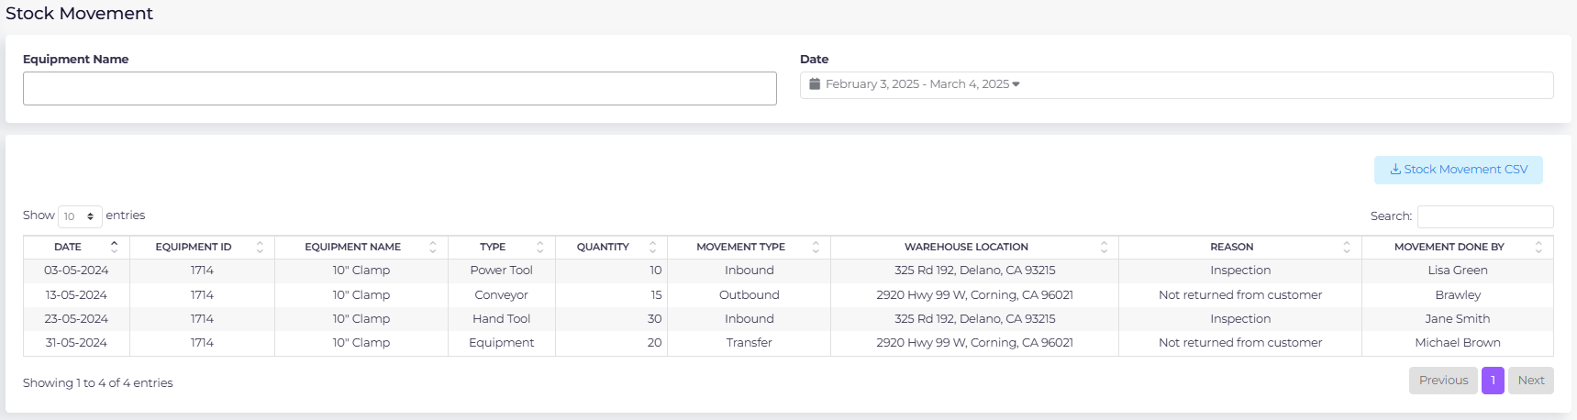
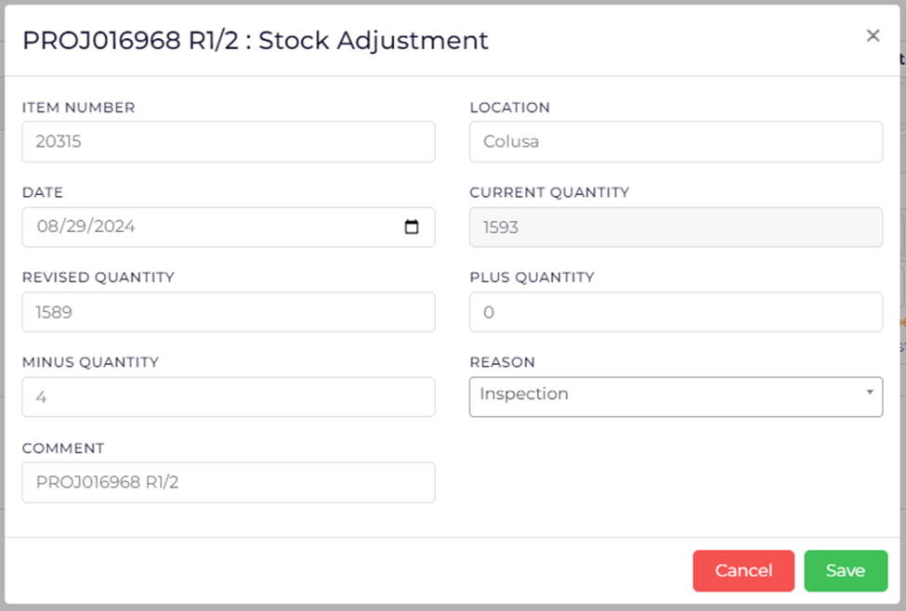
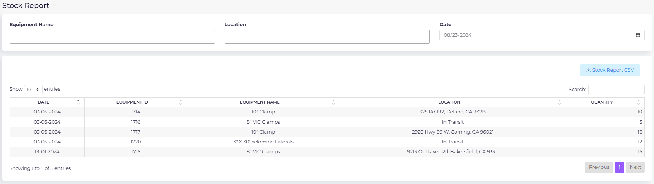
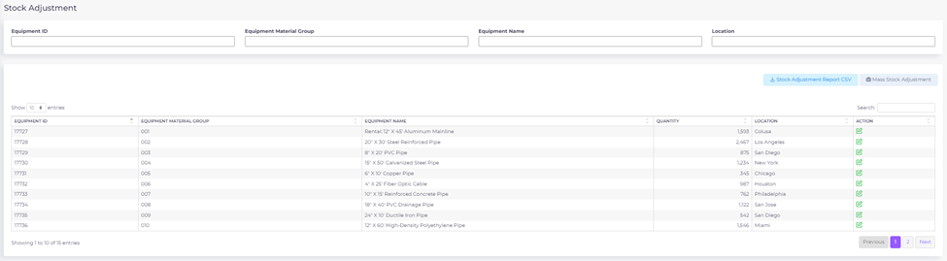
Warehousing Tool
RESULTS & VALUE CREATED
Cost Savings
Reduces operational costs by optimizing warehouse space, resources, and inventory turnover, leading to lower overhead and better cost management.
Operational Efficiency
Streamlines warehouse operations with real-time inventory tracking, automated order fulfillment, and efficient stock adjustments.
Inventory Optimization
Provides real-time visibility into stock levels, minimizing overstocking and understocking, while optimizing inventory based on demand trends.
Enhanced Service Delivery
Faster processing and precise inventory management lead to quicker order fulfillment, boosting overall performance and customer trust.

Slide 17
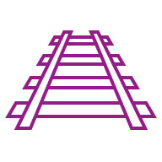
Data & Reporting Current State Assessment
INDUSTRY
OUR APPROACH
Industry: Private Equity
Sector: Investment Management
Size: Small (10-50 employees)
Analysis
Analyze key reports and core systems (e.g Deal Cloud, 4Degrees, LP360…) identifying data and reporting gaps and data quality issues
Quick Wins
Identify quick wins early in the process so that the company can already experience immediate benefits (e.g Deal Cloud usage optimization)
THE CHALLENGE
Conduct a comprehensive analysis of the company´s complex web of existing data and reporting processes, identifying interconnections between processes and critical gaps and inefficiencies, to map a clear path forward towards their “To Be” vision of streamlined, automated and consolidated data and reporting management.
Data Collection
Conduct extensive discovery sessions and walkthrough meetings per department to understand data flow and dependencies
Recommendations and Roadmap
Provide strategic recommendations per department and cross departmental regarding infrastructure, architecture, reporting and governance processes mapped in a roadmap
Results delivered as a document package and in an interactive Web Portal

Slide 18
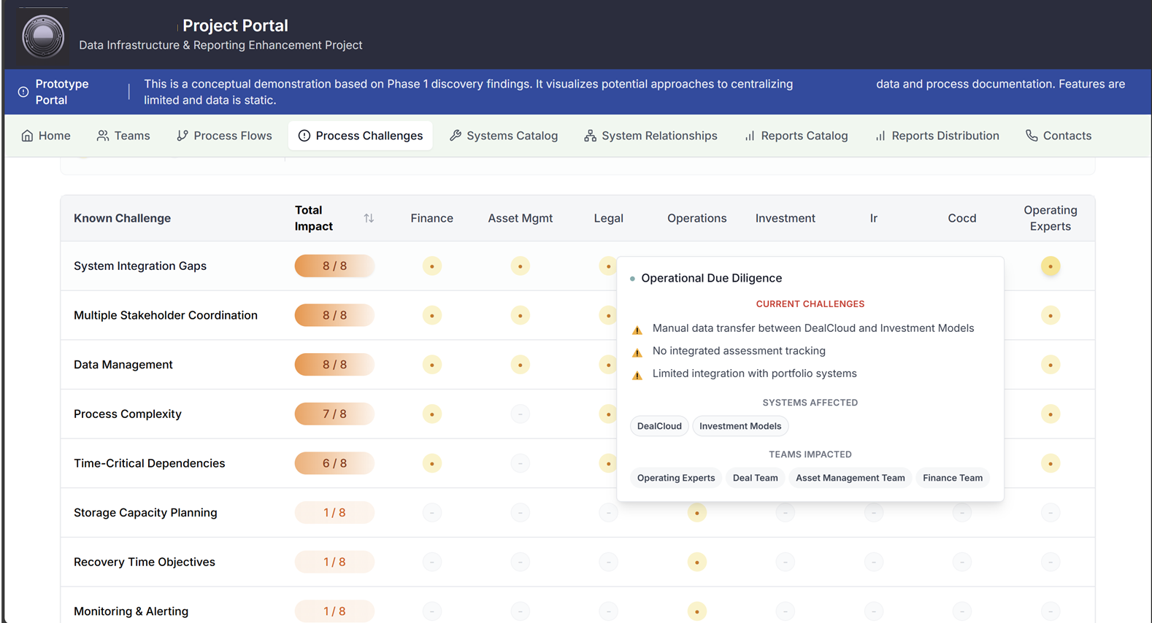

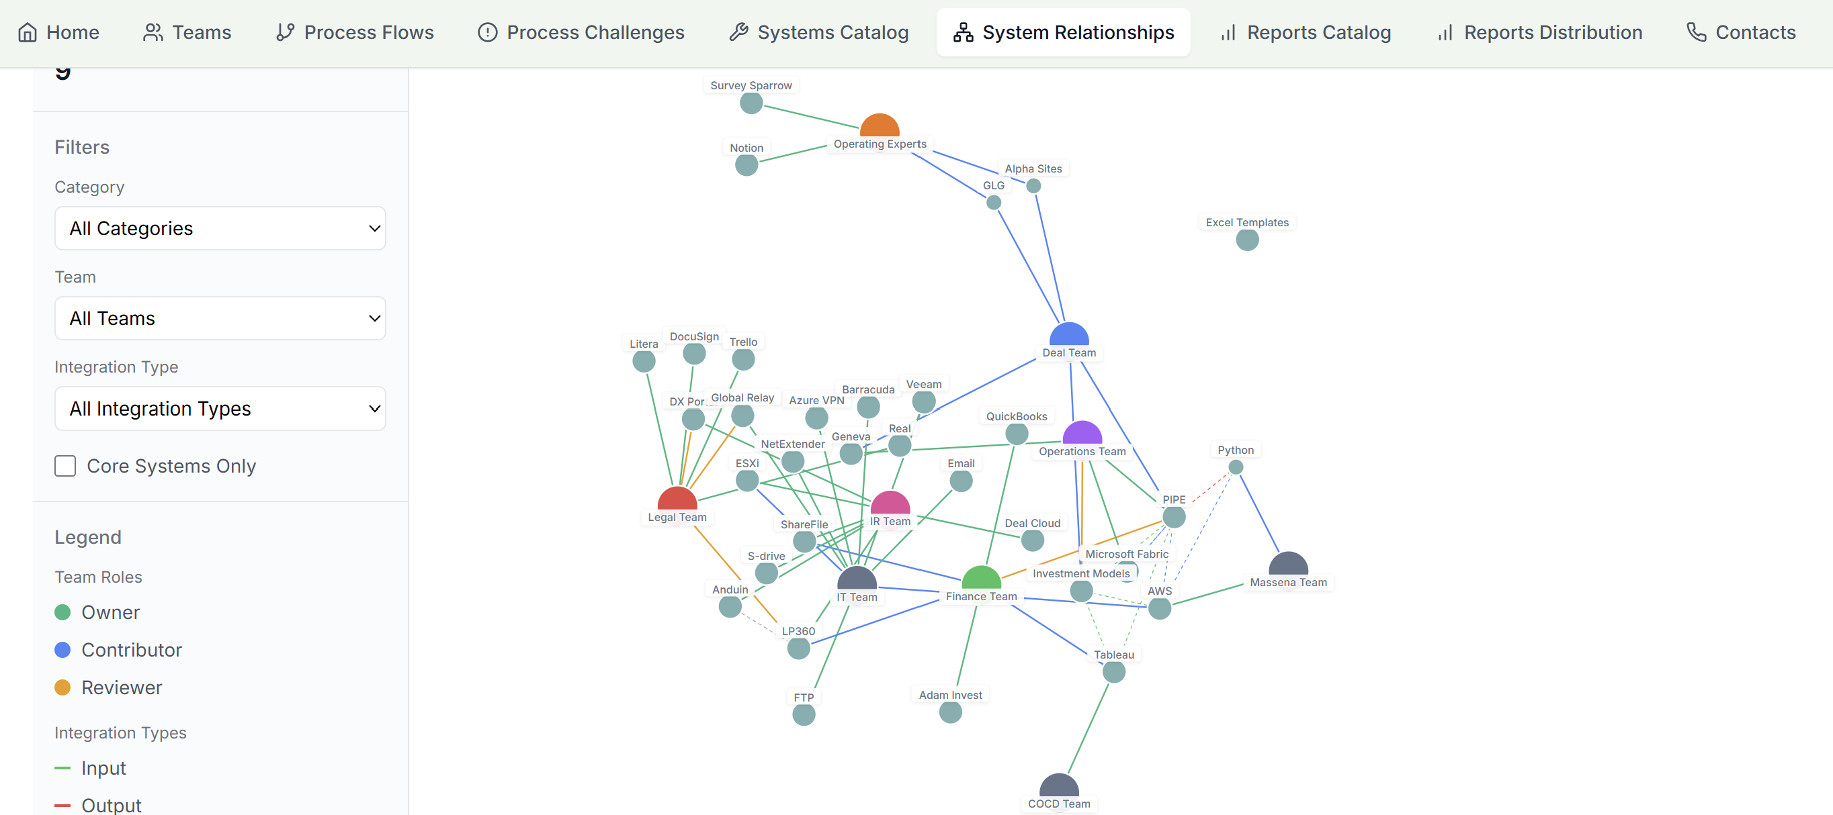
Data & Reporting Discovery
RESULTS & VALUE CREATED
Build Foundation for Effective Decision- Making
Build a data strategy that aligns with business goals, addresses specific challenges and prioritizes improvement initiatives based on impact and feasibility
Improved Efficiency and Productivity
Reduced manual effort, streamline processes eliminating redundancies and improving reporting cycles
Enhanced Data Quality and Reporting
Improve accuracy and reliability of reports and analysis by addressing data quality issues and provide more accurate and insightful reporting
Create a Data-Driven Culture
Promote transparency, foster collaboration and data sharing across department and identify training needs to empower employees to use data effectively

Slide 19
Data Warehouse
INDUSTRY
OUR APPROACH
Build Data Marts & Curated Datasets – Structure and optimize data for seamless integration with BI tools, dashboards, and automated reporting, ensuring efficient access to insights.
Industry: Private Equity
Sector: Investment Management
Size: Small (10-50 employees)
Connect systems via APIs, ETL processes, or direct integrations, consolidating data into a structured SQL-based data warehouse.
THE CHALLENGE
Fragmented data sources and manual reporting, relying on Excel exports from various ERP and CRM systems. Without a centralized data warehouse, reporting was time-consuming, inconsistent, and lacked real-time insights, making it difficult to track deals, fund performance, and investor commitments. The firm needed an integrated data solution to improve efficiency, accuracy, and analytics capabilities while ensuring better data governance.
Evaluate existing data landscape, identify gaps, and design a scalable data warehouse architecture tailored to client’s needs.
Define data models, governance frameworks, and business rules, ensuring clean, reliable, and automated data pipelines.

Slide 20
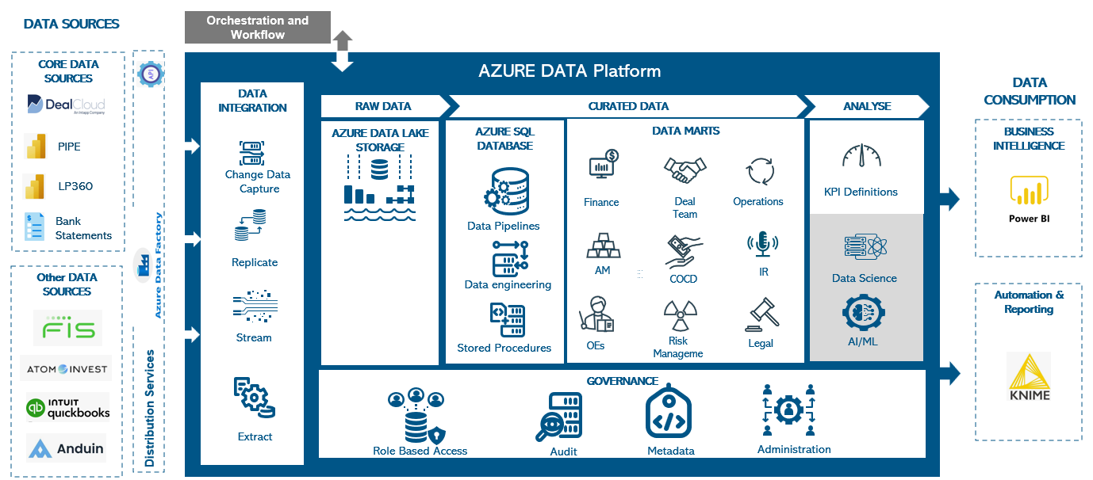
Data Warehouse
RESULTS & VALUE CREATED
One Source Of True for Firm Data
centralized, reliable data architecture, ensuring consistency, accuracy, and accessibility across the organization.
Enhanced Efficiency & Automation
reduces errors, saves time, and streamlines workflows, enabling teams to focus on analysis rather than data wrangling.
Scalability & Future Proofing
flexible architecture adapts to business growth and supports advanced analytics, AI, and automation.
Improved Decision-Making
With real-time, structured, and well-governed data, our solutions empower leadership with faster, data-driven insights for strategic and operational success.

Slide 21
Business Intelligence
INDUSTRY
OUR APPROACH
Custom Alerts & Notifications
Configure automated alerts for anomalies, threshold breaches, or critical insights to enable proactive decision-making.
Industry: Private Equity
Sector: Investment Management
Size: Small (10-50 employees)
Automated Report Generation
Create scheduled and on-demand reports with key performance metrics.
THE CHALLENGE
Manually managing dashboards and consolidating data from multiple sources is time-consuming and error prone. The organization faced challenges such as delayed reporting, inconsistent data formats, lack of real-time insights, and high dependency on manual effort, making it difficult to track performance and identify trends.
Data Collection & Integration
Gather and store structured data from multiple sources for a unified view.
Real-Time Dashboards & Insights
Provide interactive dashboards with filtering, visualization, and trend analysis capabilities.

Slide 22
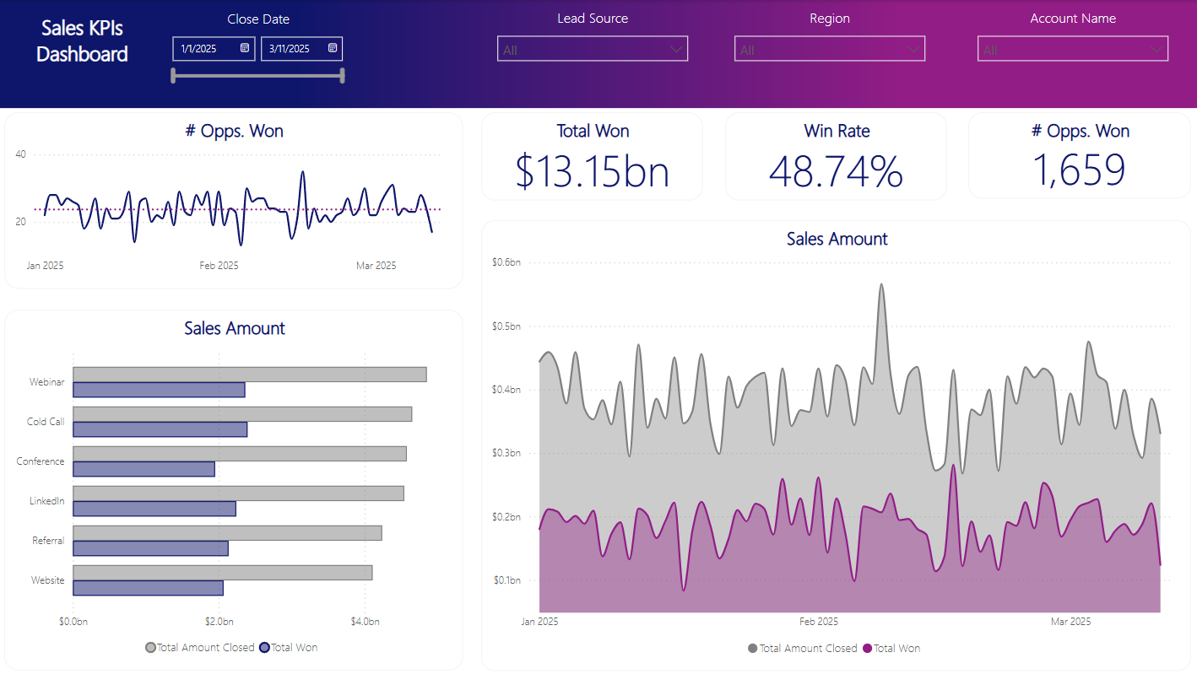
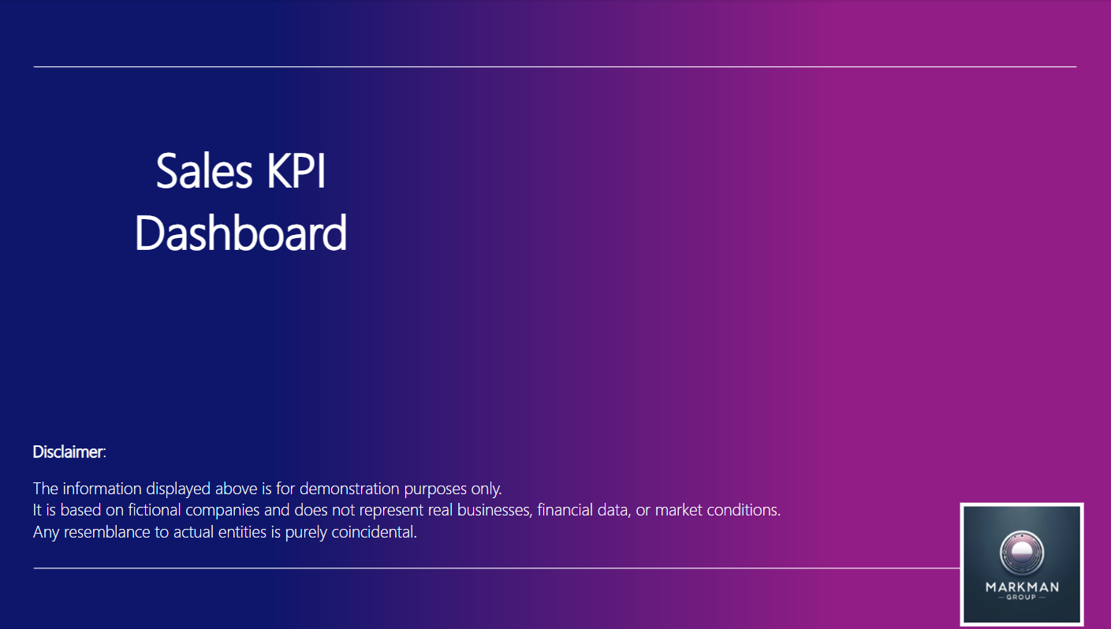
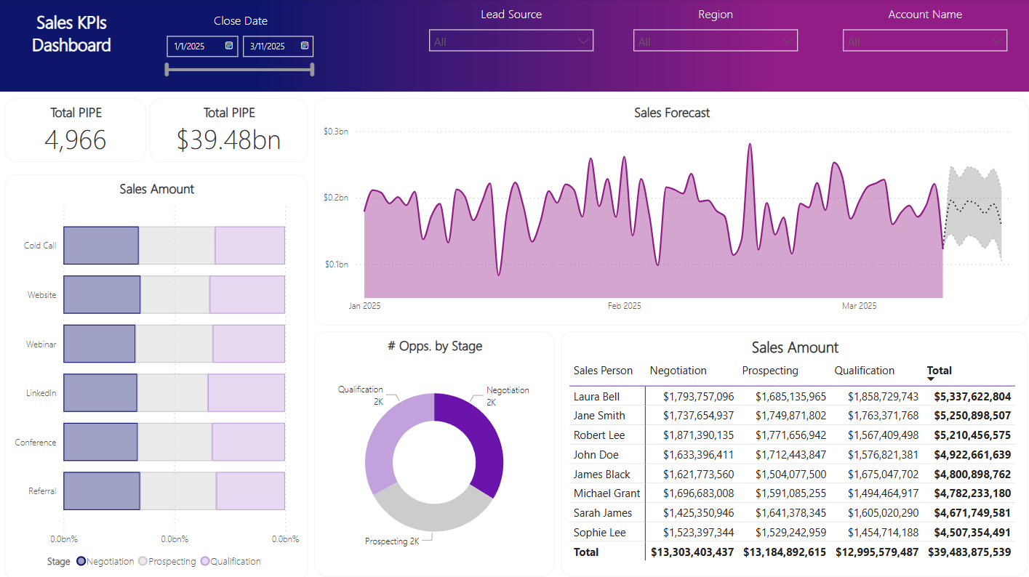
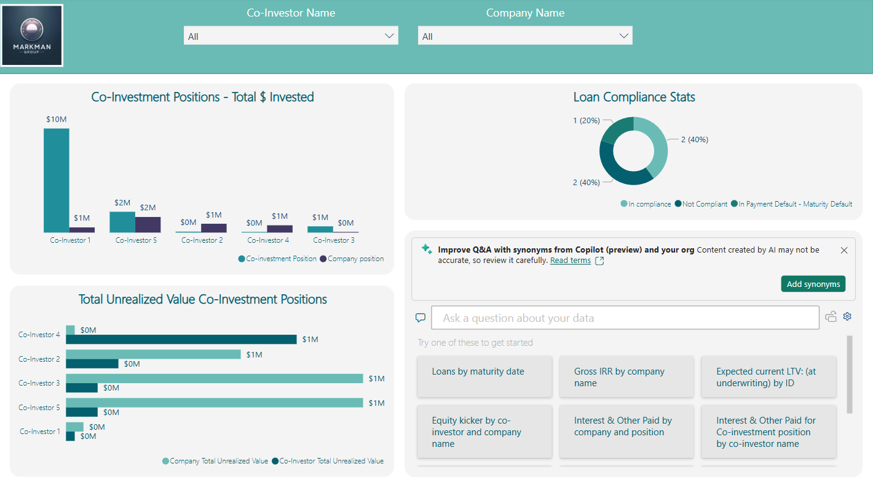
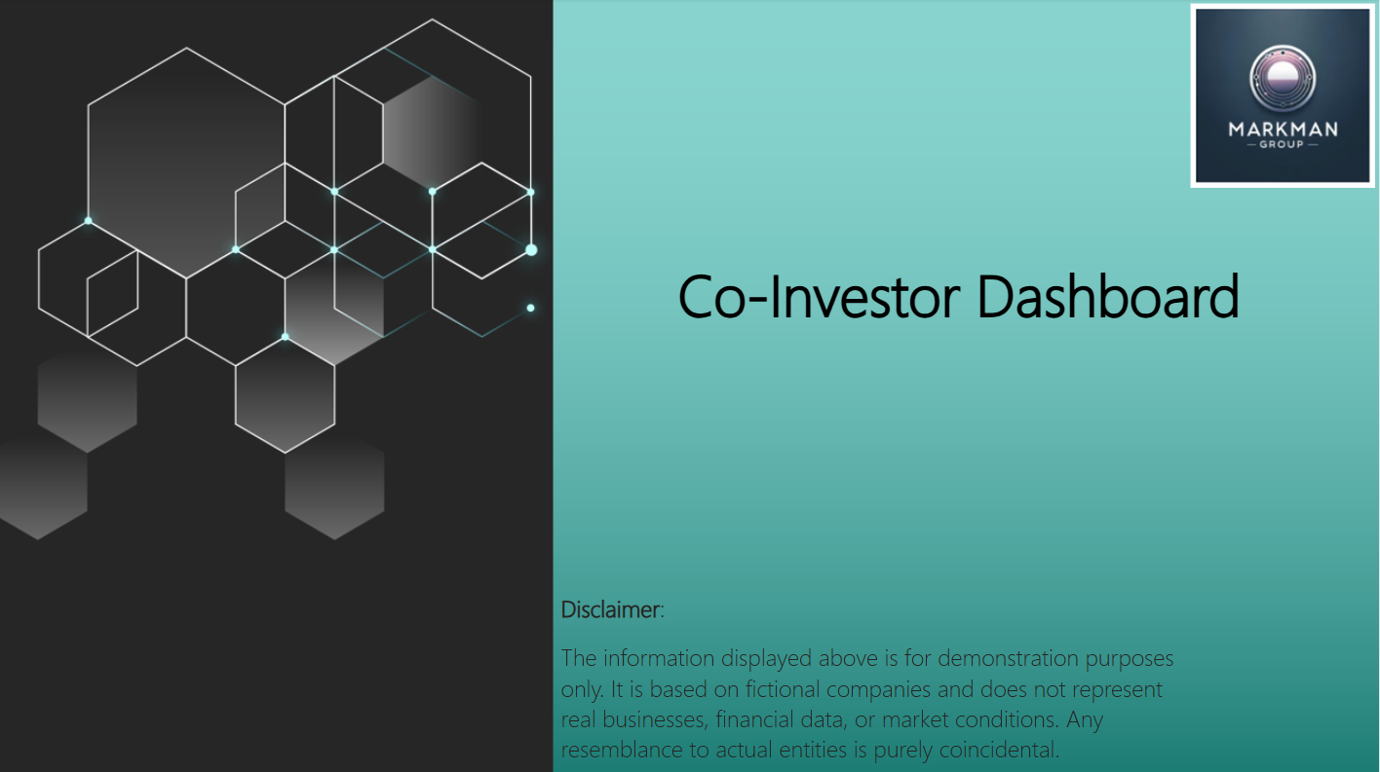
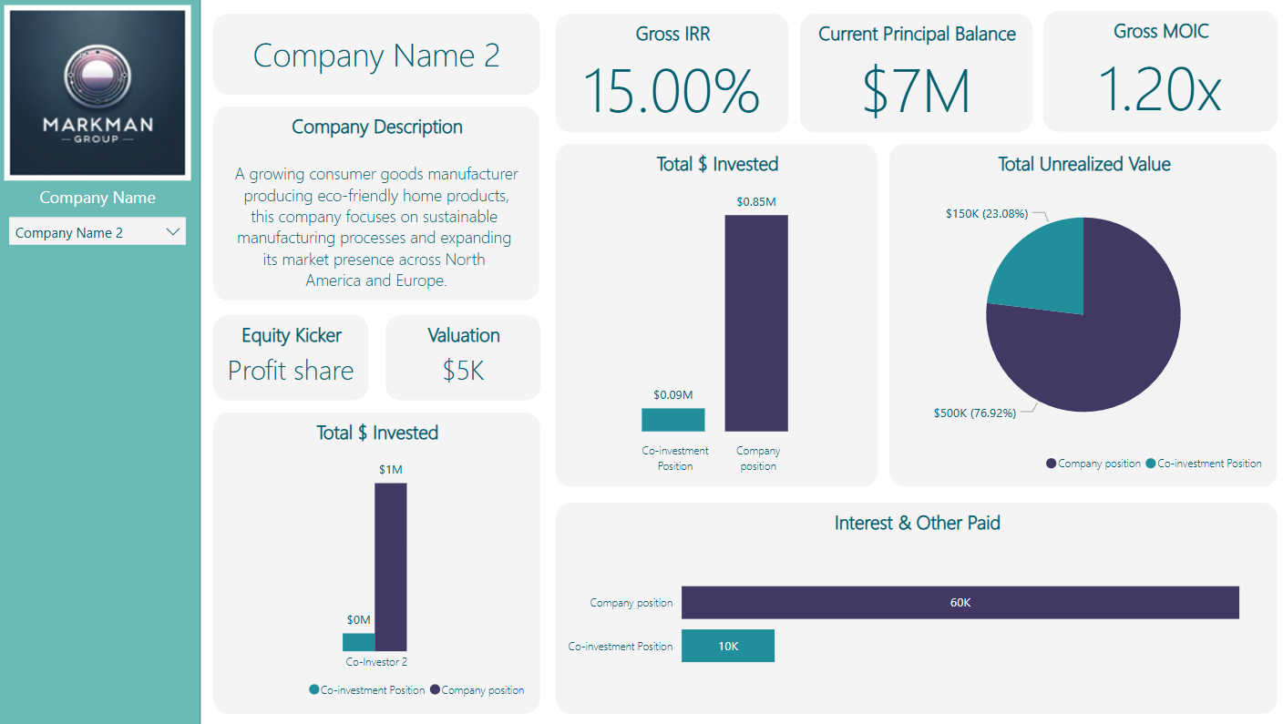
Business Intelligence
RESULTS & VALUE CREATED
Cost Savings
By automating processes and identifying resource optimization opportunities, the BI solution has reduced operational costs and minimized manual labor.
Enhanced operational efficiency
Streamlined workflows and centralized data, improving coordination and allowing teams to focus on higher-value tasks.
Improved decision-making
Thanks to accurate, data-driven insights and predictive analytics, leaders are now making more informed and strategic decisions, driving business growth.
Real-time insights
With real-time data at their fingertips, the organization can now respond quickly to changes and make proactive decisions based on up-to-the-minute insights.

Slide 23
OCR & Custom Approval Web App
INDUSTRY
OUR APPROACH
Industry: Construction
Sector: Commercial & Residential Building
Size: Medium (100-250 employees)
Real-time Insights & Reporting
The system generates standard and customizable reports on invoice status, approval status/times, etc.
OCR-Based Data Extraction
Extracts key invoice details such as vendor name, amount, and date for processing.
THE CHALLENGE
Managing over 15,000 invoices annually through a fully manual process creates challenges, including time-consuming receipt handling, approval routing bottlenecks, and error-prone data entry. The lack of automation and visibility across the process leads to inefficiencies, delayed payments, and increased compliance risks.
Automated Document Retrieval
The system monitors a centralized inbox and automatically downloads invoice attachments.
3. Web App Integration
An integrated approval tool provides workflow automation, allowing authorized personnel to review and approve invoices efficiently while maintaining audit trails and compliance.

Slide 24


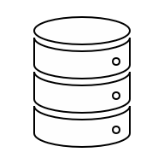
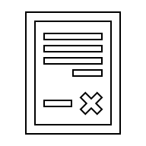
OCR & Custom Approval Web App
RESULTS & VALUE CREATED
1. Email monitoring & data extraction
3. System Integration
Increased Efficiency
Automates invoice data extraction, processing, and reconciliation, reducing manual effort.
Enhanced Accuracy
Uses OCR and AI-driven validation to minimize human errors.
Cost Savings
Reduces operational expenses by automating repetitive tasks.
2. Document approval and coding
Scalability
Supports growing business needs with automation and adaptability.

Slide 25


PROJECT SUPPORT
markman-group.com
connect@markmanassociates.com

Slide 26
Project Support
OUR APPROACH
We take a structured and proactive approach to project and change management for all our projects, ensuring seamless execution from initiation to completion. By integrating strategic planning, stakeholder engagement, risk management, and continuous improvement, we drive successful outcomes while adapting to evolving business needs.
INITIATION AND PLANNING
We begin by defining project objectives, scope, and key stakeholders. This includes conducting feasibility studies and resource planning to ensure a strong foundation for success. A clear roadmap is developed, setting milestones and expectations.
EXECUTION AND IMPLEMENTATION
We manage resources, coordinate teams, and oversee project deliverables. We ensure that timelines, budgets, and quality standards are met while proactively identifying and mitigating potential risks. Effective communication and collaboration drive project success.
CHANGE MANAGEMENT
We assess the impact of changes on stakeholders, processes, and systems, ensuring a structured approach to transitions. By providing training, communication plans, and stakeholder engagement, we facilitate smooth adoption and minimize disruptions.
MONITORING AND OPTIMIZATION
We track project performance against key metrics and gather feedback. Continuous improvement strategies are applied to enhance future projects, ensuring long-term efficiency and effectiveness.
Notes:
We specialize in delivering tailored application development services designed to meet the unique needs of your business. Our approach combines innovative technology with a deep understanding of your specific requirements, ensuring that every solution is efficient, scalable, and aligned with your business goals. We focus on providing high-quality, customized applications that drive business growth and streamline processes.

Slide 27
